Slide 1
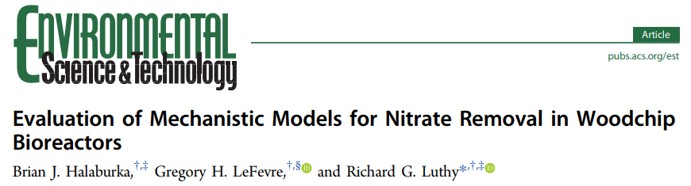
Lena Abu-Ali
Clare O’Connor
Lingzi Xia
Prepared for CEE 6570
May 4th, 2018

Slide 2
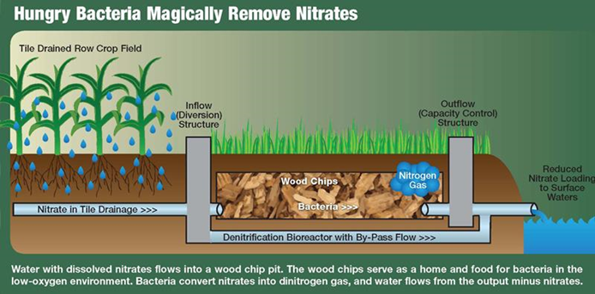
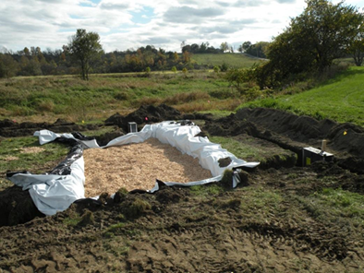
Pictures of woodchip bioreactors
New York State Water Resources Institute
From University of Illinois Extension

Slide 3
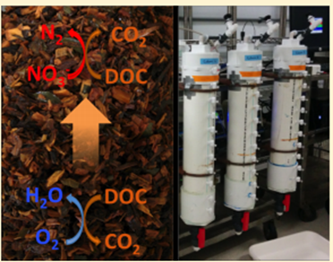
Introduction - Woodchip bioreactors (WBR)
Agricultural runoff and urban stormwater
Inexpensive
Renewable
High permeability
High C/N ratio

Slide 4
Introduction - Mechanisms & Models
Denitrification rate
Factors:
Age, temperature variation, packing density of carbon source
Critical parameters:
Dissolved oxygen (DO), nitrate, dissolved organic carbon (DOC)
Models
Zero order, first order, one-dimensional transport models
Results were inconclusive or not representative

Slide 5
Methods - Column Design & Tracer Test
A mix of species
Dried→ Sieved(2-10mm)→Compacted(packing density 0.18)
Porosity
Interval pulse bromide tracer test
•Linear porewater velocity -ν
•Dispersion coefficients –D

Slide 6
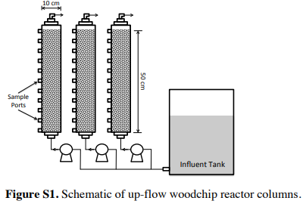
Methods - Column experiments & Sampling
Column Experiments
• Three influent nitrate concentrations(11, 5, and 2 mg-N /L)
• Different flow rates (1.5, 3.8, and 8.4 mL /min )
• 21℃, upflow
Sampling
• Along the entire length for DO, nitrate, and DOC
• Four times during a period of 1 week
• Collected from all ports and the artificial stormwater matrix tank
• Downward-each sample was representative of the porewater at or just above the sample port

Slide 7
Modeling- Overview
5 overall models of composed of three coupled equations
Model 1: considers DO, DOC, nitrate (M-M)
Model 2: considers DOC, nitrate (M-M)
Model 3: considers DO, nitrate (M-M)
Model 4: considers nitrate (M-M)
Model 5: considers nitrate (zeroth order)

Slide 8
Modeling - Assumptions
(1) System is in steady state and the transient term is zero
(2) Microbial biomass is constant within each region and fixed to surfaces so that the microbial biomass terms X_{O} and X_{N} can be combined with V_{O} and V_{N}
(3) Substrate and electron acceptors (O₂ and NO₃⁻) are the only limitations to sustaining growth
(4) all DOC is labile and bioavailable and only dissolved substrate is taken up by bacteria

Slide 9
Modeling - Assumptions
(5) Insoluble substrate mass remains relatively constant due to the longevity of wood chips
(6) Sorption and intraparticle diffusion of DOC through wood chips are not important as the equations are solved at steady state.

Slide 10
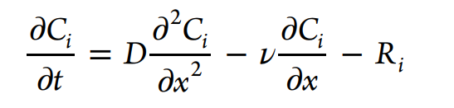
Modeling- Development
1D advection dispersion equations with coupled Michaelis-Menten
Similar to other transport models to describe substrate movement in porous media
C_{i} : concentration of ith species
D: dispersion coefficient
ν : effective porewater velocity
R_{i} : biological reaction rate for ith species

Slide 11
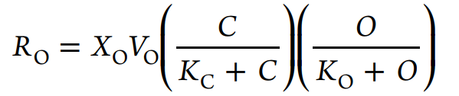
Modeling- Development
For each species, the reaction rate term changes:
Where, for dissolved oxygen (for aerobic respiration) is:
R_{o} : rate of oxygen uptake
X_{o}: aerobic heterotroph biomass
V_{o}: maximum rate of dissolved oxygen uptake
C : concentration of DOC
O : concentration of dissolved oxygen
K_{O} and K_{C}: half-saturation constants for DO and DOC, respectively

Slide 12
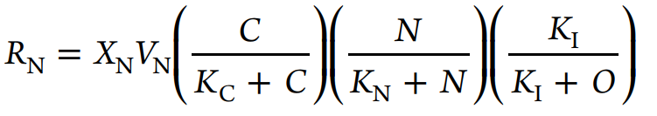
Modeling- Development
For each species, the reaction rate term changes:
Where, for nitrate (in denitrification) is:
R_{N}: rate of denitrification
X_{N} : concentration of heterotrophic denitrifiers
V_{N} : maximum rate of denitrification
N: concentration of nitrate
K_{I} : inhibition constant of DO
K_{N} : half-saturation constant of nitrate

Slide 13
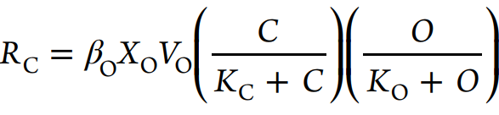
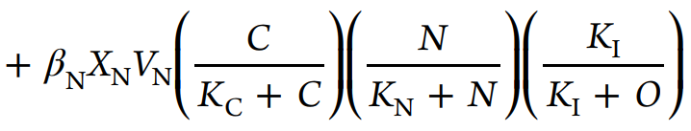
Modeling- Development
For each species, the reaction rate term changes:
Where, for DOC (from aerobic respiration and denitrification) is:
β_{O} : uptake coefficient for DO (mg DOC consumed per mg of DO)
β_{N} : uptake coefficient for nitrate (mg DOC consumed per mg of nitrate)
But wait there’s more!

Slide 14
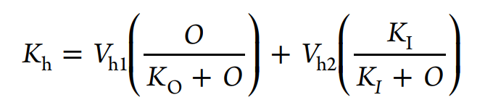
Modeling - Development
DOC is also produced during the cellulose hydrolysis!
This release is greater during the first ~13 months of use and decreases following a power law, as well as varying in anoxic and oxic conditions
V_{h1} : aerobic maximum DOC production
V_{h2} : anaerobic maximum DOC production
K_{h} : DOC production rate

Slide 15
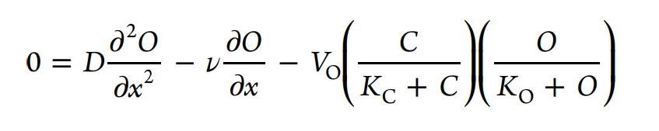
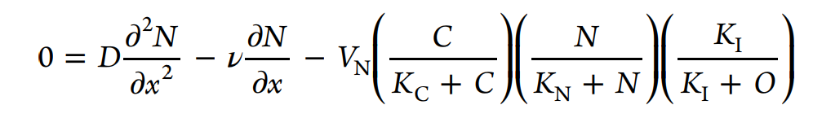
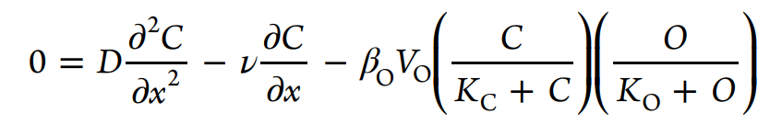
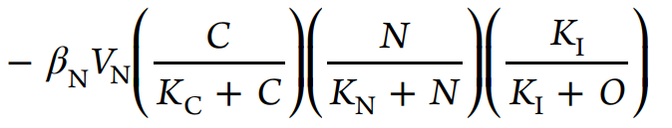
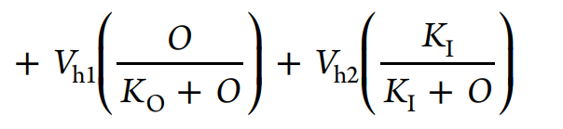
Modeling - Model 1
Dissolved Oxygen:
Nitrate:
Dissolved Organic Carbon:

Slide 16
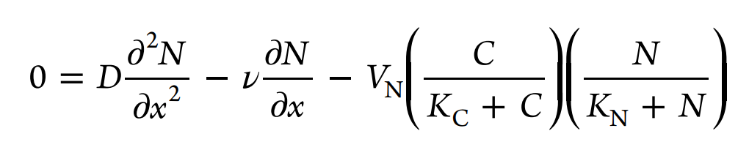
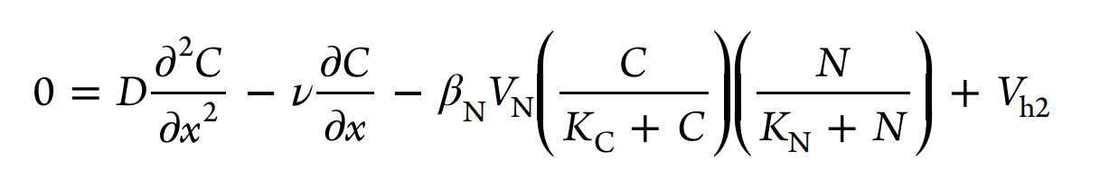
Modeling - Model 2
Nitrate:
Dissolved Organic Carbon:

Slide 17
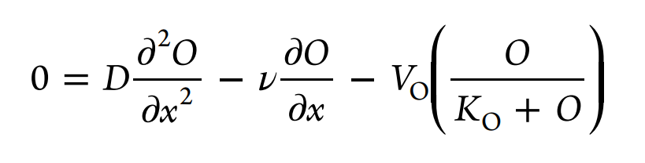
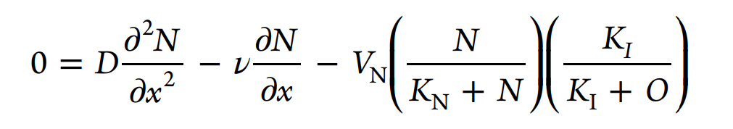
Modeling - Model 3
Dissolved Oxygen:
Nitrate:

Slide 18
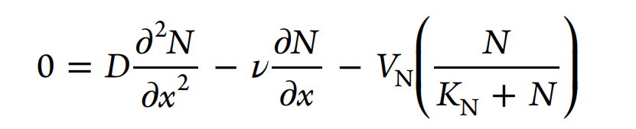
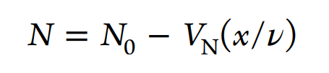
Modeling - Models 4 and 5
Model 4: Nitrate
Model 5: Zeroth Order

Slide 19
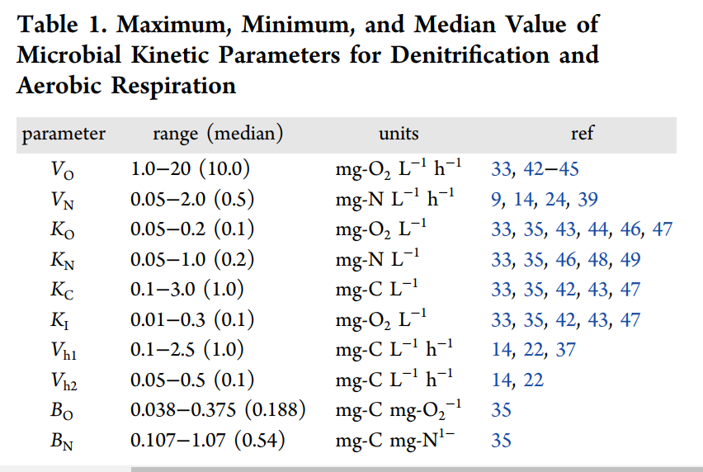
Modeling - Parameters
Model 1, as the most complex model set the number of parameter to be estimated.
The ranges shown come from the literature

Slide 20
Modeling - Parameter Setting and Evaluation
- Sensitivity Analysis performed on all models
- Parameters determined to be insensitive were set at the most commonly cited value
- The values that were obtained through tracer tests were included as well

Slide 21
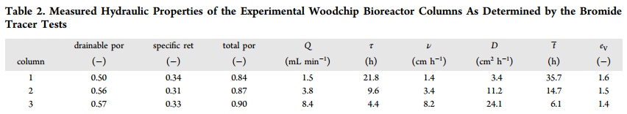
Results - Tracer Tests
Average drainable porosity: 0.54 +/- 0.04
Hydraulic efficiency between 1.4 and 1.6
HRT may have been underestimated

Slide 22
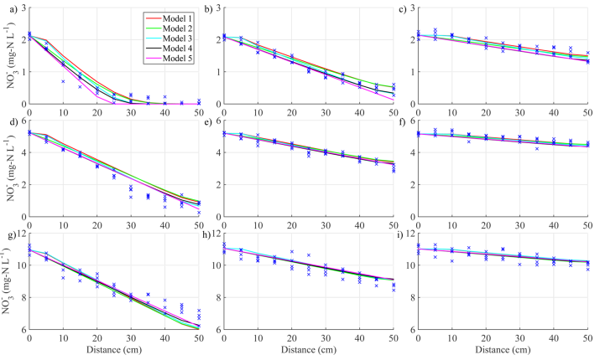
Results - Column Experiments
Column 1
Column 2
Column 3
Nitrate removal rate: 2.53 +/- 0.39 g-N/m³-d
Low reported rate may be due to larger effective porosity
Rapid consumption of DO observed
Increasing nitrate →
Increasing velocity →
Notes:
Nitrate removal rates ranged from 0.10 to 0.16 mg/L per hour, with an average removal rate of 0.13 +/- 0.02 mg/L N per hour

Slide 23
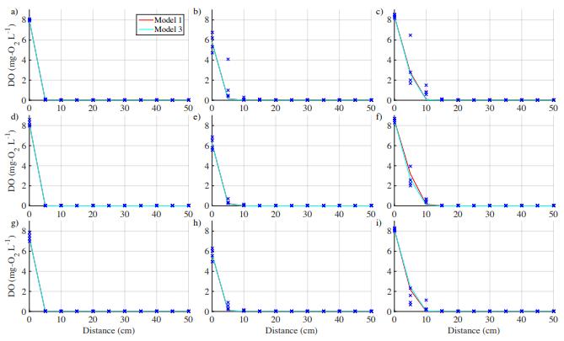
Results - Column Experiments
Column 1
Column 2
Column 3
Increasing nitrate →
Increasing velocity →

Slide 24
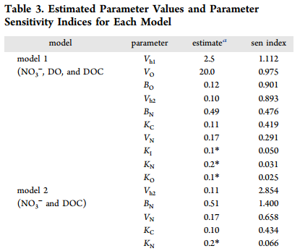
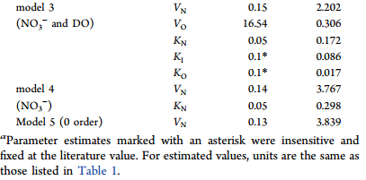
Results - Parameter Estimation
Most sensitive parameters were inconsistent across models
Least sensitive parameters were consistent
Michaelis-Menten half saturation constants, K_{O} and K_{N}
Oxygen inhibition constant, K_{I}

Slide 25
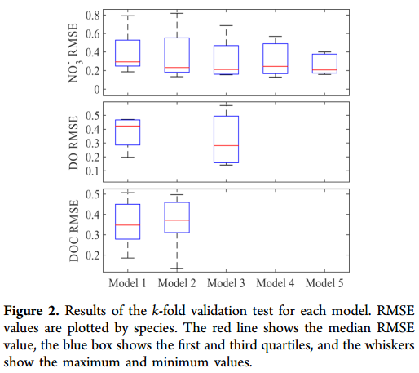
Results - Model Evaluation
Nitrate: k-fold validation tests revealed similar test RSME
ANOVA test found no significant difference between RSME values of the different models
No significant difference between the models for predicted DO and DOC

Slide 26

Results - Model Evaluation
Best overall pick: Model 5 (Zero-order model)
Honorable Mentions:
Best for mechanistic understanding: Model 1 (full model)
Best for DOC & nitrate: Model 2
Best for DO & nitrate: Model 3

Slide 27
Results - Model Evaluation
Why does the zero-order model have a similar prediction error to more complex models?
DO inhibition may have a relatively minor effect on denitrification rates
DOC concentrations may have a minor impact on denitrification rates
Michaelis-Menten kinetics may be unnecessary
Half-saturation and inhibition constants insensitive for all models
*This analysis is valid under the conditions of this study - model performance may vary under different conditions

Slide 28
Environmental Implications
HRT may be difficult to determine in horizontal-flow reactor beds
Fluctuating flow rates and saturation levels
Denitrification intermediates
Denitrification rates are highly dependent on temperature
Zero-order model may be modified using a Van’t Hoff-Arrhenius function
DO inhibition may become relevant below 21ºC
DOC depletion may become relevant above 21ºC
Woodchip age may affect overall nitrate reduction rate

Slide 29
Questions?

